Slide 1
Week 11
Assignment：Load Balancing Problem
Name：张颜兵
Id：12132428
Department：MAE
SuperVisor：Prof.吴雷
Research Topic：Engineering calculation

Slide 2
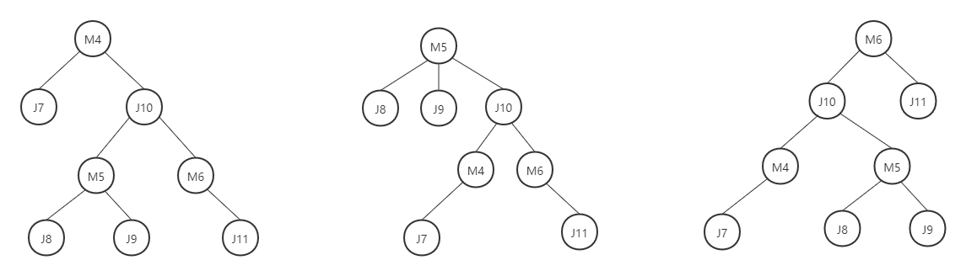
E1 All possible tree
$$Generate all possible tree structures from the following graph.$$

Slide 3
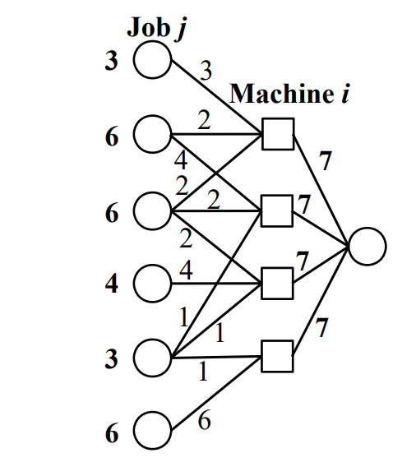
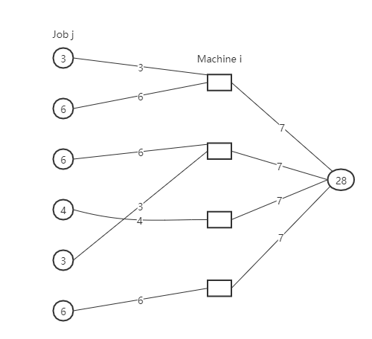
E2 No cycle graph
$$精品Change the flow of each edge along the cycle without changing the total$$
$$input to each node and the total output from each node.$$

Slide 4
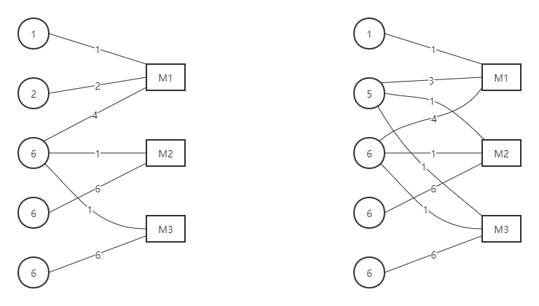
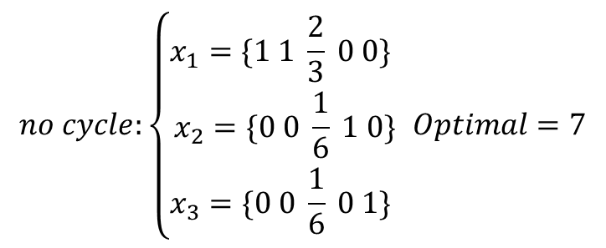
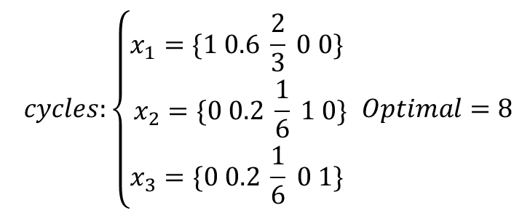
E3 Cycles or not
$$no cycle:\left\{\begin{aligned}x_{1}=\{1 1 \frac{2}{3} 0 0\} \\ x_{2}=\{0 0 \frac{1}{6} 1 0\} \\ x_{3}=\{0 0 \frac{1}{6} 0 1\} \end{aligned}\right. Optimal=7$$
$$cycles:\left\{\begin{aligned}x_{1}=\{1 0.6 \frac{2}{3} 0 0\} \\ x_{2}=\{0 0.2 \frac{1}{6} 1 0\} \\ x_{3}=\{0 0.2 \frac{1}{6} 0 1\} \end{aligned}\right. Optimal=8$$

